Slide 1

Training Cats: Presenting Security to Senior Management
Brian K. Duncan
Cyber Defense Operations Leader
Procter & Gamble

Slide 2

Brian K. Duncan
Procter & Gamble 19 Years
Software Developer
Controls Engineer
Business Continuity and Disaster Recovery Leader
Information Security
Cyber Defense Operations Leader
Incident Response
Penetration Testing
Threat Hunting
Threat Intelligence
Threat Management
Info Sec Certifications: OSCE, OSCP, CISSP, CCTHP, AWS CCP

Slide 3

Training Cats: Presenting Security to Senior Management.
Goals
Gain buy-in from the top
Reach a challenging audience
Improve Security for the company
Methods
Find what the cat likes, it will help you focus on the right priorities.
Keep the cat’s attention by engaging them in meaningful ways.
Don’t be smarter than the cat! Everyone knows cats want to be smarter than you!
Notes:
Presenting Security to Senior Management is very important. Buy-in from the top is critical for the success of any security program. These techniques have helped me reach a challenging audience…not unlike training cats. Using these tips and suggestions, hopefully you will be able to improve security for your company.
If you can Find what the cat likes, it will help you focus on the right priorities. You must also Keep the cat’s attention by engaging them in meaningful ways. And last, Don’t be smarter than the cat! Everyone knows cats want to be smarter than you!
This presentation has a few tips and a lot of tricks for effectively:
Presenting Security to Senior Management.

Slide 4
Methods
Find what the cat likes: Focus on (Security) Priorities
Keep the cat’s attention: Engage Your Audience
Don’t be smarter than the cat: Simplify the Complex

Slide 5

Find what the cat likes: Focus on (Security) Priorities
Identify the priorities of the audience.
Translate any business priorities into security priorities.
CIO vs. CISO vs. CEO vs. COO will be different
Common topics are:
Once the topic is chosen, find a way to present it in a way that is relatable.
Business | Security Translation (not all-inclusive)
Governance & Compliance | Data Breaches, Phishing
Employee Awareness | Device Security, Phishing, Ransomware
Privacy | Data Breaches, Phishing
Corporate Travel | Device Security, Phishing
Notes:
Even though they know it’s good for them, sometimes you have to present security in a way that is appealing. You have to be flexible enough and aware enough to “find what the cat likes”. Who are your cats, and what do they like? Once you know what they like, then the goal is to present it in a way they can understand it.
Identify the top security priorities of the audience.
Translate any business priorities into security priorities.
CIO vs. CISO vs. CEO vs. COO will be different

Slide 6


Find what the cat likes: Generally, all cats like Phishing
EXAMPLE EXERCISE
We phish before conferences with Senior Management.
Outline for the phishing campaigns:
Get alignment and approvals to phish
Coordinate with the SOC
Create a compelling phish
Our go-to phish runs a PowerShell script that takes a screenshot of the laptop and a picture using the laptop webcam, then uploads those files to a server. We scan the photos for sensitive information before playing them in front of people during our talk.
Notes:
In-house spear phishing works very well!
Senior Mangers understand the concept of being phished. They have heard of phishing and can spot basic scams. Most have never even considered donating to the deposed prince of Nigeria.
We help Senior Managers understand:
Dangers of phishing
Spear phishing
How to spot an advanced phish
Safe email practices
Coordinate with the event sponsor/coordinator.
Get necessary approvals.
We create our own event agendas in Excel, hiding the macro inside.
Create a copy of the event Agenda (Excel reliably runs the AutoOpen macro)
We don’t try to circumvent security alerting, in case the phish is distributed.
We use a custom-written PowerShell script that takes a screenshot on the target’s laptop as well as a webcam picture. These photos are automatically uploaded to our server.
We send the phish on a break, before our talk. The screenshots and images are current and relevant..
Phish from an Event Coordinator email address

Slide 7
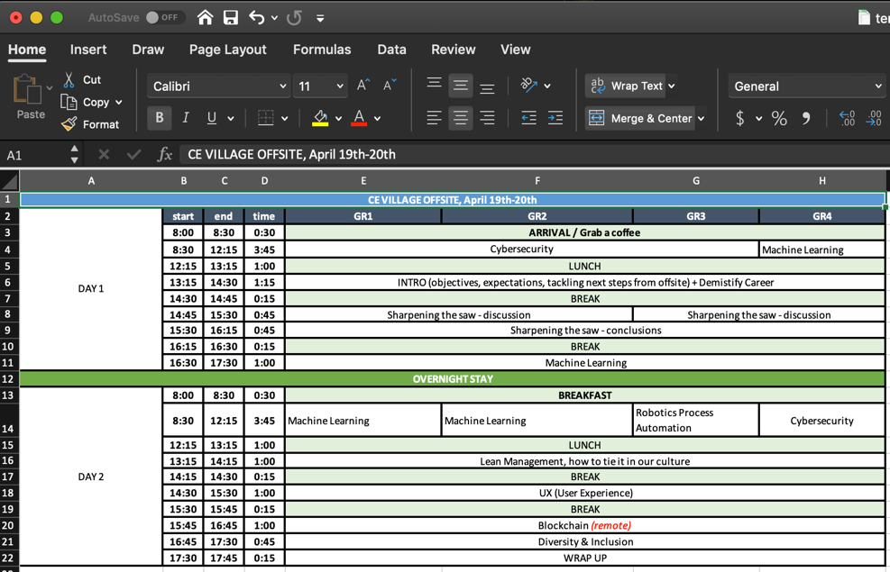
Notes:
Sample agenda

Slide 8


Find what the cat likes: Cats like their treasures to be safe
EXAMPLE EXERCISE
Deploy pseudo-ransomware (via phishing or bash bunny)
Discuss delivery methods
Describe the Effects
Review your policies
Tie the exercise back to the priorities.
I developed an AutoHotKey (AHK) script that emulates the way ransomware takes over a machine. This script traps all basic keyboard and mouse actions for a short time (configurable). It does not do anything malicious to the computer.
https://github.com/ralphyz/pseudo-ransomware
Notes:
Use ransomware examples to stress the effects and highlight security policies.
Example Effects:
Cost of restoring compromised devices
System downtime / Productivity Loss
Data Loss
Example Policies:
Don’t pay the ransom
Don’t pay the ransom
Don’t pay the ransom
We have deployed a pseudo-ransomware program to stress the importance of the topic. We have done this both through manual deployment as well as phishing.
I developed an AutoHotKey (AHK) script that emulates the way ransomware takes over a machine. This script traps all basic keyboard and mouse actions for a short time (configurable). It does not do anything malicious to the computer.

Slide 10


What are other things that cats like?
Home Network Security
Personal VPN
Router Setup
Camera/Security System Configuration
Security when traveling abroad
Device Security (laptop/tablet/phone)
Password Security / MFA
WiFi/Bluetooth Safety
Internet of Things
Information Technology / Operational Technology (ITOT)

Slide 11
Methods
Find what the cat likes: Focus on (Security) Priorities
Keep the cat’s attention: Engage Your Audience
Don’t be smarter than the cat: Simplify the Complex

Slide 12

Keep the cat’s attention
We have found that if we can get in front of our senior leaders for a hands-on event, that is the most effective way to get the cat’s attention.
Consider the 70 / 20 / 10 model for Learning and Development.
People learn:
70% - Through hands-on experience
20% - From others
10% - Formal / Professional Training
We often set up VMs for our management to use for hands-on training.

Slide 13


Keep the cat’s attention with Hands-On Password Cracking
EXAMPLE EXERCISE
Using virtual machines, we have our Senior Managers crack passwords.
Setup:
Windows VM with Remote Desktop enabled
Hash list on Desktop
Password Cracking Software
L0phtCrack password cracker https://sectools.org/tool/l0phtcrack/
https://asecuritysite.com/encryption/lmhash – create small, sample list that will crack easily
https://hashes.org – download hash lists
Notes:
We have set up VMs for several training classes, giving them a guided tour of password cracking using L0phtCrack and small, customized hash-lists to crack. Most cracking activities happen in under 1 minute using lists of several thousand hashes.
We use fake hash-lists in VMs to demonstrate how easy it is to crack a password. We have used hashcat, John the Ripper, and Cain and Able.
But our go-to password cracker for a hands-on demo is L0phtCrack with sample LM Password hashes. They crack fast and the tool is easy for beginners to use.

Slide 14
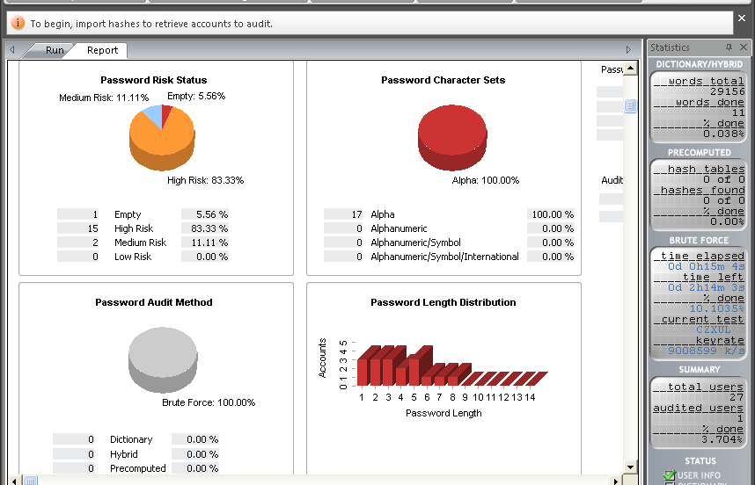

Slide 15


Keep the cat’s attention with Have I been Pwned
EXAMPLE EXERCISE
Steps:
Have audience visit https://haveibeenpwned.com
Search for familiar email addresses
Review the output
This drives the message home that even if you are secure, not every website you visit is always secure. We use this as an opportunity to talk about passwords: complexity, reuse, MFA, etc.
Notes:
On the topic of password security, ‘;--have I been pwned? is a great resource for audience participation. We have the audience visit the website and enter email addresses they know about.
We ask the audience to visit Have I Been Pwned and enter email addresses they know about to determine if the addresses were exposed in data breaches. We have never had someone tell us they didn’t find an email addresses from this site.
We power-on a WiFi pineapple and have the audience look at the available wifi networks. Some of them actually connect to a bogus network automatically. We show the network options on the screen and talk about wireless security.

Slide 16
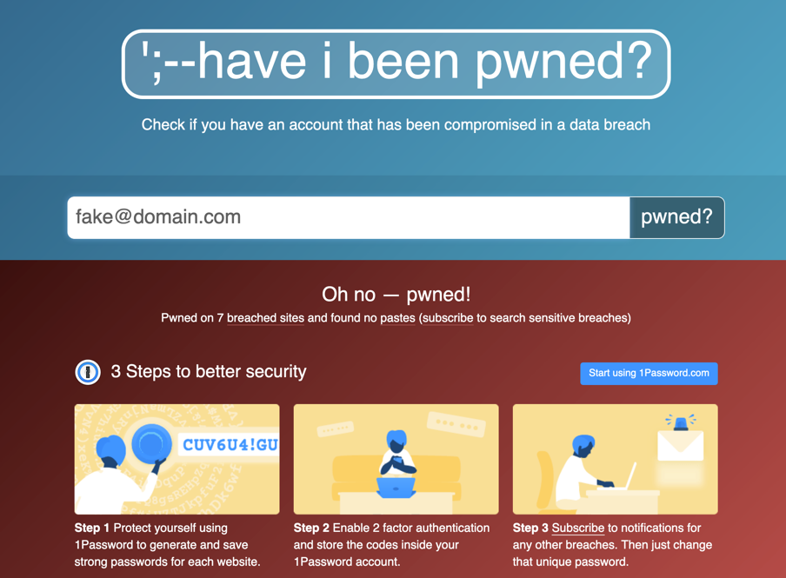

Slide 17

What are other ideas that will keep your cat’s attention?
Cats are competitive: Create teams that compete with one another.
Social Engineering
Phish Spotting
Phish Creating
Cats are interested in new things: Show them the toys you have.
Cats love motion: we have created videos of common tools we use:
Password Cracking
Bash Bunny
Privilege Escalation

Slide 18
Methods
Find what the cat likes: Focus on (Security) Priorities
Keep the cat’s attention: Engage Your Audience
Don’t be smarter than the cat: Simplify the Complex

Slide 19

Don’t be smarter than the cat!
Information Security often feels:
Difficult
Tedious
Cumbersome
Try and demonstrate that Info Sec does not have to be complex!
Easy to demonstrate topics:
Password Strength
WiFi Pineapple
Bash Bunny
Notes:
What we do in Information Security often seems difficult or impossible. If we demonstrate that anyone can do it, Senior Management is more likely to take an interest.

Slide 20


Don’t be smarter than the cat - Password Strength
EXAMPLE EXERCISE
Explain Password Best Practices:
Long Passphrases
Avoid the obvious
No password reuse
2FA wherever possible
Secure Connections
Password Manager
Debunk Misconceptions
Password cracking: dictionary vs. brute-force
Notes:
In hands-on demonstrations, we discuss password cracking, and give users the chance to crack hashes.
When hands-on is not feasible, we talk about Kraken – our in-house password cracking server. For <$5,000, we built our own GPU based password cracking machine. This allows us to crack hashes gathered on penetration tests and Red Team engagements.
Through videos and slides: we demonstrate how easy it is to crack passwords quickly in various formats: NTLM, SAP BCODE, DES crypt, etc.. We give examples of each of these, and where they can (or could) be found in our environment. We also share some facts such as: we can guess ~192MH/s in NTLM format against dictionary attacks.
rockyou.txt has 14.3 Million passwords
CrackStation has 1.4 Billion passwords
Misconceptions:
Passwords need to be complicated
You have to remember passwords
Long complex passwords are always secure

Slide 21
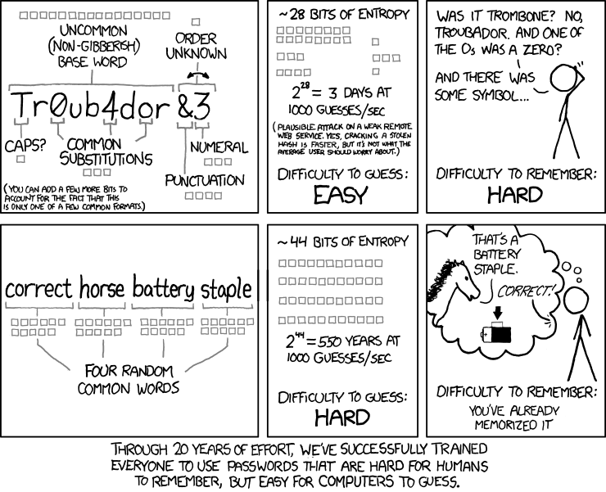
Don’t be smarter than the cat – Password Strength
https://xkcd.com/936/
Notes:
Example of how complexity isn’t important

Slide 22
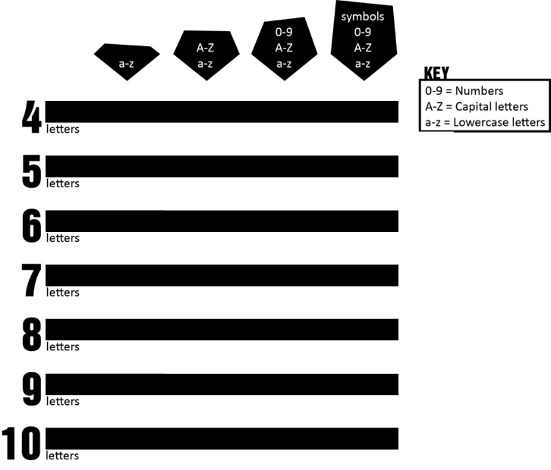
Don’t be smarter than the cat – Password Strength
s = seconds
m = minutes
h = hours
d = days
M = months
1.6s
29s
1.7m
6s
25.5m
1.7h
2.6m
22.1h
4.5d
4.5d
1.1h
1.6M
9.3M
1.1h
Notes:
Performance of our <$5K password cracking server.

Slide 23


Don’t be smarter than the cat – WiFi Pineapple
EXAMPLE EXERCISE
Run the WiFi Pineapple.
Have people view available WiFi networks on their phones.
Explain:
The reason the WiFi networks are available
How the insecure network SSIDs can be used against you
WiFi Pineapple - https://shop.hak5.org/products/wifi-pineapple
Notes:
Hak5’s tool, WiFi Pineapple, is a great way to demonstrate wireless network and mobile device security. Turn it on, and it will grab SSID names from devices trying to connect to known wireless networks.
We power-on a WiFi pineapple and have the audience look at the available wifi networks. Some of them actually connect to a bogus network automatically. We show the network options on the screen and talk about wireless security.

Slide 24
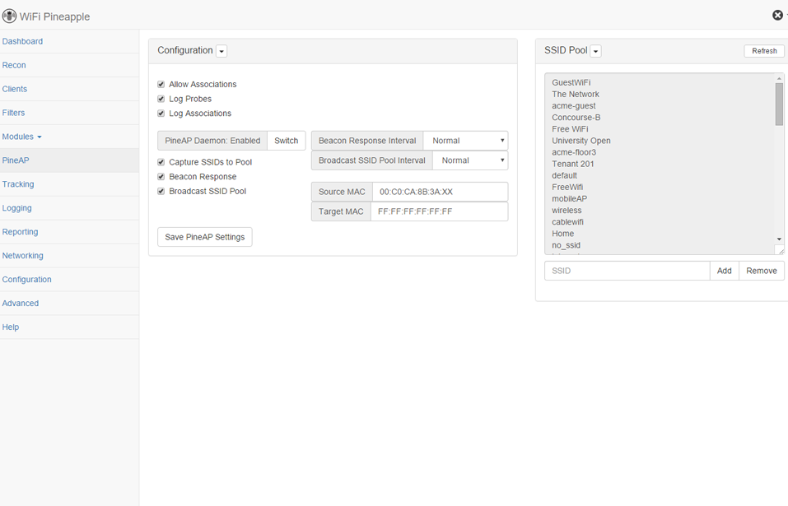
Notes:
Sample PineAP screen.

Slide 25


Don’t be smarter than the cat – Bash Bunny
EXAMPLE EXERCISE
During conferences, the team uses several Bash Bunny devices with custom payloads to change wallpapers of conference attendees’ unattended (and unlocked) laptops and explain the need for device security.
Bash Bunny – https://shop.hak5.org/products/bash-bunny
My custom Bash Bunny payloads are in the official payload repo at:
https://github.com/hak5/bashbunny-payloads/tree/master/payloads/library
prank/R4Z-ThemeChanger
execution/R4Z-VBScript
remote_access/R4Z-MacReverseShell
remote_access/R4Z-ReverseShell
Notes:
Hak5’s tool, Bash Bunny, operates like a Human Interface Device (HID / Keyboard).
Customized payloads can be created to send keystrokes to a computer.
R4Z (short for RalphyZ) are the payloads I created while doing penetration testing. The ThemeChanger is used to deploy a custom wallpaper. With USB Blocking in place, sometimes we must get creative and download the payload before executing it.

Slide 26
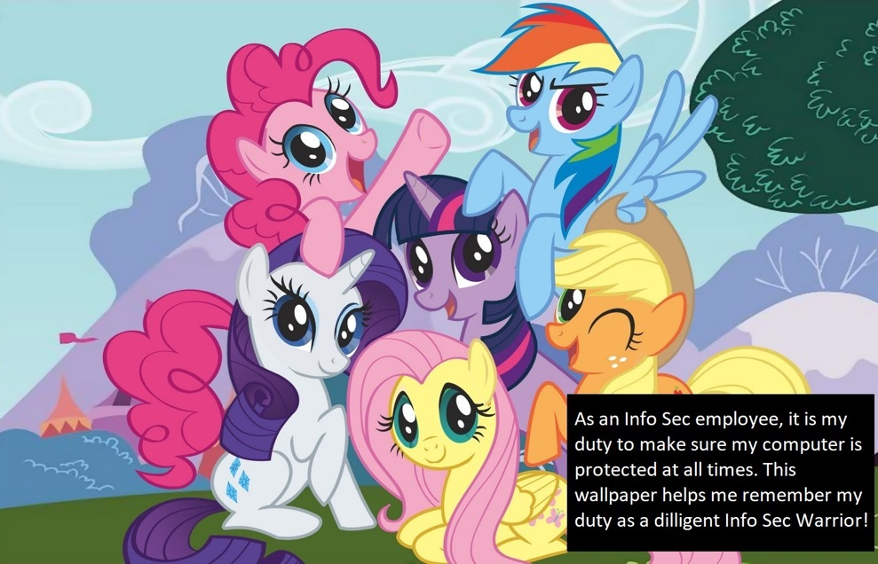

Slide 27







Things I have learned as a cat trainer:
Cats have different personalities – tailor the message
Cats have different backgrounds – tailor the approach
Cats have different interests – tailor the delivery
Notes:
Senior Managers!!!
Some are shy, some are outgoing
Finance, Product Supply, Marketing, Sales, IT
Can you make it relatable?

Slide 28

Recap
Hopefully you can now:
Find what the cat likes by focusing on the right priorities.
Keep the cat’s attention by engaging them in meaningful ways.
Don’t be smarter than the cat by simplifying the complex.

Slide 29
